Slide 1





Phishing Campaign
Phase 1
28th – 30th June 2021
EUC Team (India & US), Server Support, RMC Team
28th
29th
30th
Delivery Australia, Delivery Japan, Delivery US, Delivery UK
Delivery Bangalore, Delivery Noida, Delivery Kolkata, Delivery Hyderabad, MTeam – India
Finance India, Facilities, HR Ops, HR Business Partners, TA BLR, TA Noi
Microsoft Teams - Added To New Team
Free Offers
Suspicious Login Attempt
Microsoft Teams - Added To New Team
Work from Home Reimbursement
New Course Enrollment Phishing
Salary Range [Multi]
Suspicious Login Attempt
Account Verification – spoofing
HR File Sharing
Infected Device
Spoofed Websites
HR US, US Hiring, Cleaning Crew
Spoofed Websites
Brute Force Attack
Sales Team, Marketing Bangalore, IS Team
Suspicious Login Attempt
Account Verification – spoofing
Microsoft Planner - Task Assigned
New Course Enrollment Phishing
Free Offers
Microsoft Planner - Task Assigned
Salary Range [Multi]
Brute Force Attack
Infected Device

Slide 2
Phishing Campaign
Phase 2
23rd – 24th Sep 2021
EUC Team (India & US), Server Support, RMC Team
23
24
US-Hiring
Delivery Noida, Delivery HYD, Delivery Kolkata
Delivery US, Delivery Bangalore
TA BLR
Nomination for Technical Program
Timesheet Reminder
New Payroll System
Microsoft Task Assignment
Detected Harmful File
Grubhub Gift Card Acceptance
Password Reset
Unauthorised Login - Intl.
Suspicious Login Attempt
Microsoft Task Assignment
Detected Harmful File
Password Reset
Microsoft Teams - Added to new team HR File Sharing
GrubHub Gift Card Acceptance Detected Harmful File
Nomination for Technical Program
Timesheet Reminder
Microsoft Task Assignment
Detected Harmful File
Grubhub Gift Card Acceptance
<Click Bait>
<Ransomware>
<Ransomware>
<Click Bait>
Cleaning Crew,
TA Noi
HR US
Detected Harmful File
Password Reset
Document Share Copy
Microsoft Task Assignment
Password Reset
Microsoft Task Assignment
GrubHub Gift Card Acceptance Detected Harmful File
Password Reset
Microsoft Teams - Added to new team HR File Sharing
GrubHub Gift Card Acceptance Detected Harmful File
<Ransomware>
<Ransomware>
<Ransomware>

Slide 3
Phishing Campaign
Phase 3
15th – 22nd Dec 2021
EUC Team (India & US), Server Support, RMC Team
15
16
17
20
Delivery Noida (1), Delivery Bangalore (1,2,3,4)
Delivery Noida (2), Delivery Bangalore (5,6)
Delivery Hyderabad (2,3), Delivery Bangalore (7,8)
Delivery Hyderabad (1), Delivery US (1)
End of Year Bonus Password Reset
New Coure Enrollment Phishing
Microsoft Task Assignment
Log4J Detected
End of Year Bonus Password Reset
New Coure Enrollment Phishing
Microsoft Task Assignment
Log4J Detected
End of Year Bonus Password Reset
New Coure Enrollment Phishing
Microsoft Task Assignment
Log4J Detected
End of Year Bonus Password Reset
New Coure Enrollment Phishing
Microsoft Task Assignment
Log4J Detected
<Bank Issues>
<Bank Issues>
<Bank Issues>
<Bank Issues>
M Team India (1), M Team US
Cleaning Crew
M Team India (2,3)
Delivery Kolkata, Delivery Noida (3)
Detected Harmful File
Password Reset
Document Share Copy
Microsoft Task Assignment
End of Year Bonus Password Reset
HR File Sharing
New Coure Enrollment Phishing
Suspicious Login Attempt
Password Reset
Microsoft Teams - Added to new team HR File Sharing
GrubHub Gift Card Acceptance Detected Harmful File
End of Year Bonus Password Reset
New Coure Enrollment Phishing
Microsoft Task Assignment
Log4J Detected
<Bank Issues>
<Bank Issues>
<Bank Issues>
<Bank Issues>

Slide 4
Phishing Campaign
Phase 3
15th – 22nd Dec 2021
EUC Team (India & US), Server Support, RMC Team
21
22
HR US
Delivery Japan, Delivery Australia, Delivery Blr (13,14,15,16,17,18,19,20)
IS Team, M Team India (4)
Delivery Bangalore (9,10,11,12), Delivery US (2)
End of Year Bonus Password Reset
New Coure Enrollment Phishing
Microsoft Task Assignment
Log4J Detected
Password Reset
Unauthorised Login - Intl.
Suspicious Login Attempt
Microsoft Task Assignment
Detected Harmful File
End of Year Bonus Password Reset
New Coure Enrollment Phishing
Microsoft Task Assignment
Log4J Detected
Password Reset
Detected Harmful File
End of Year Bonus
Microsoft Task Assignment
Log4J Detected
Suspicious Login Attempt
<Bank Issues>
<Bank Issues>
<Bank Issues>
<Bank Issues>
TA Blr, Noida TA
Tavant Facilities
Finance India
Delivery Hyd(4), Delivery Noida(4), Delivery US (3), Delivery UK
Suspicious Login Attempt
End of Year Bonus Microsoft Task Assignment
New Course Enrollment Phishing
Password Reset
Password Reset
Microsoft Task Assignment
End of Year Bonus
Suspicious Login Attempt New Course Enrollment Phishing
Password Reset
Detected Harmful File
End of Year Bonus
Microsoft Task Assignment
New Course Enrollment Phishing
End of Year Bonus Password Reset
New Coure Enrollment Phishing
Microsoft Task Assignment
Log4J Detected
<Bank Issues>
<Bank Issues>
<Bank Issues>
<Bank Issues>

Slide 5
Phishing Campaign
Phase 4
24th – 27th May 2022
EUC Team (India & US), Server Support, RMC Team
24
25
26
27
Finance, Facilities
Tavant HR
IS Team, CC Team
Delivery Kolkata, Delivery Bangalore
File Sharing
Sign-In Notification
Survey Solicitation
Account Expiration
Microsoft Teams Outreach
File Sharing
Sign-In Notification
Survey Solicitation
Account Expiration
Microsoft Teams Outreach
Account Verification
Sign-In Notification
Survey Solicitation
Account Expiration
Microsoft Teams Outreach
Woohoo Gift Card Acceptance
Account Verification
Sign-In Notification
Survey Solicitation
Account Expiration
Microsoft Teams Outreach
Woohoo Gift Card Acceptance
<Zero Trust>
<Zero Trust>
<Zero Trust>
<Zero Trust>
Delivery Hyderabad, Delivery US
Delivery Noida
Marketing Team, Sales Team
M Team India, M Team US
File Sharing
Sign-In Notification
Survey Solicitation
Account Expiration
Microsoft Teams Outreach
File Sharing
Sign-In Notification
Survey Solicitation
Account Expiration
Microsoft Teams Outreach
Account Verification
Sign-In Notification
Survey Solicitation
Account Expiration
Microsoft Teams Outreach
Woohoo Gift Card Acceptance
Account Verification
Sign-In Notification
Survey Solicitation
Account Expiration
Microsoft Teams Outreach
Woohoo Gift Card Acceptance
<Zero Trust>
<Zero Trust>
<Zero Trust>
<Zero Trust>

Slide 6
Phishing Campaign
Phase 5
23rd – 26th Aug 2022
EUC Team (India & US), Server Support, RMC Team
23
24
25
26
Tavant HR
Finance, Facilities
IS Team, CC Team
Delivery Kolkata, Delivery Bangalore
File Sharing
Sign-In Notification
Survey Solicitation
Account Expiration
Microsoft Teams Outreach
File Sharing
Sign-In Notification
Survey Solicitation
Account Expiration
Microsoft Teams Outreach
Account Verification
Sign-In Notification
Survey Solicitation
Account Expiration
Microsoft Teams Outreach
Woohoo Gift Card Acceptance
Account Verification
Sign-In Notification
Survey Solicitation
Account Expiration
Microsoft Teams Outreach
Woohoo Gift Card Acceptance
<Zero Trust>
<Zero Trust>
<Zero Trust>
<Zero Trust>
Delivery Hyderabad, Delivery US
Delivery Noida
Sales Team
M Team India
File Sharing
Sign-In Notification
Survey Solicitation
Account Expiration
Microsoft Teams Outreach
File Sharing
Sign-In Notification
Survey Solicitation
Account Expiration
Microsoft Teams Outreach
Account Verification
Sign-In Notification
Survey Solicitation
Account Expiration
Microsoft Teams Outreach
Woohoo Gift Card Acceptance
Account Verification
Sign-In Notification
Survey Solicitation
Account Expiration
Microsoft Teams Outreach
Woohoo Gift Card Acceptance
<Zero Trust>
<Zero Trust>
<Zero Trust>
<Zero Trust>

Slide 7
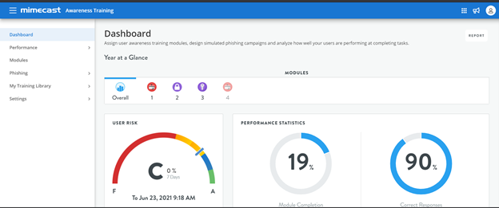
Mimecast ‘Awareness’ module - SOP
Mimecast Dashboard:-
In Dashboard, we can see the overall results of all the scheduled modules.
Also, for all the module categories, we can see the insights like how many users completed the training, how many users provided the correct answer and user risk for the organization.

Slide 8
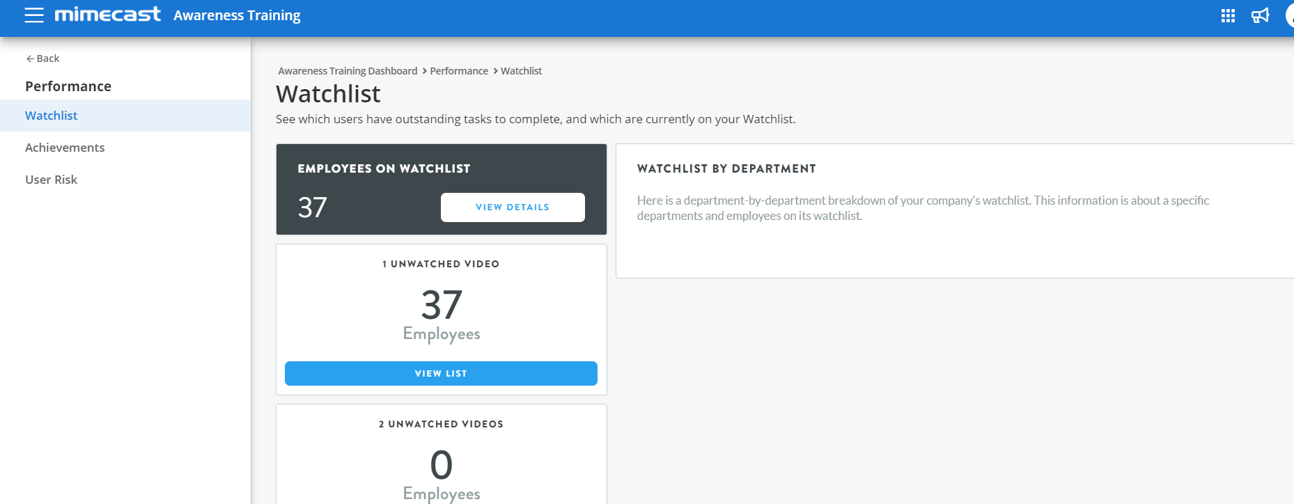
Mimecast ‘Awareness’ module - SOP
Performance:- By using this tab, we can analyze the performance of user both at the department level and user level. It is divided into three parts:
1. WatchList
2. Achievements
3. User Risk
A. Watchlist:- If a user does not complete the assigned module within a month, they will be add to the watchlist user.

Slide 9
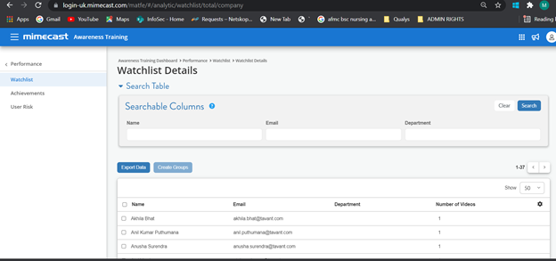
Mimecast ‘Awareness’ module - SOP
To know the additional details about the user who are listed in watchlist tab, click on view details option. This displays each user's:
Name
Email address.
Department
Unwatched Videos

Slide 10
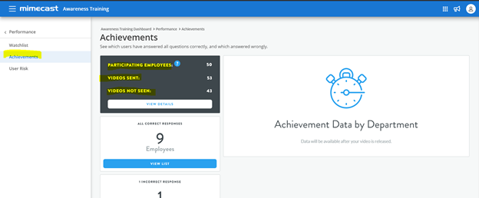
Mimecast ‘Awareness’ module - SOP
B. Achievement:- It contains the overview of user performance which contains the details of total number of participating employees, videos sent, videos not viewed and users who've all correct or incorrect responses.

Slide 11
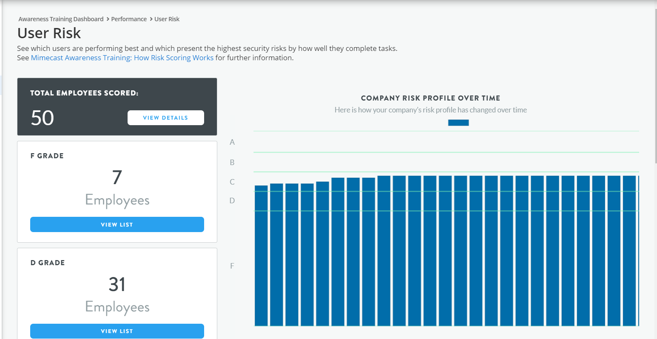
Mimecast ‘Awareness’ module - SOP
C. User Risk:- It provides the details of those users who are the risk for the organization and in which part they are failing and what needs to improve.

Slide 12
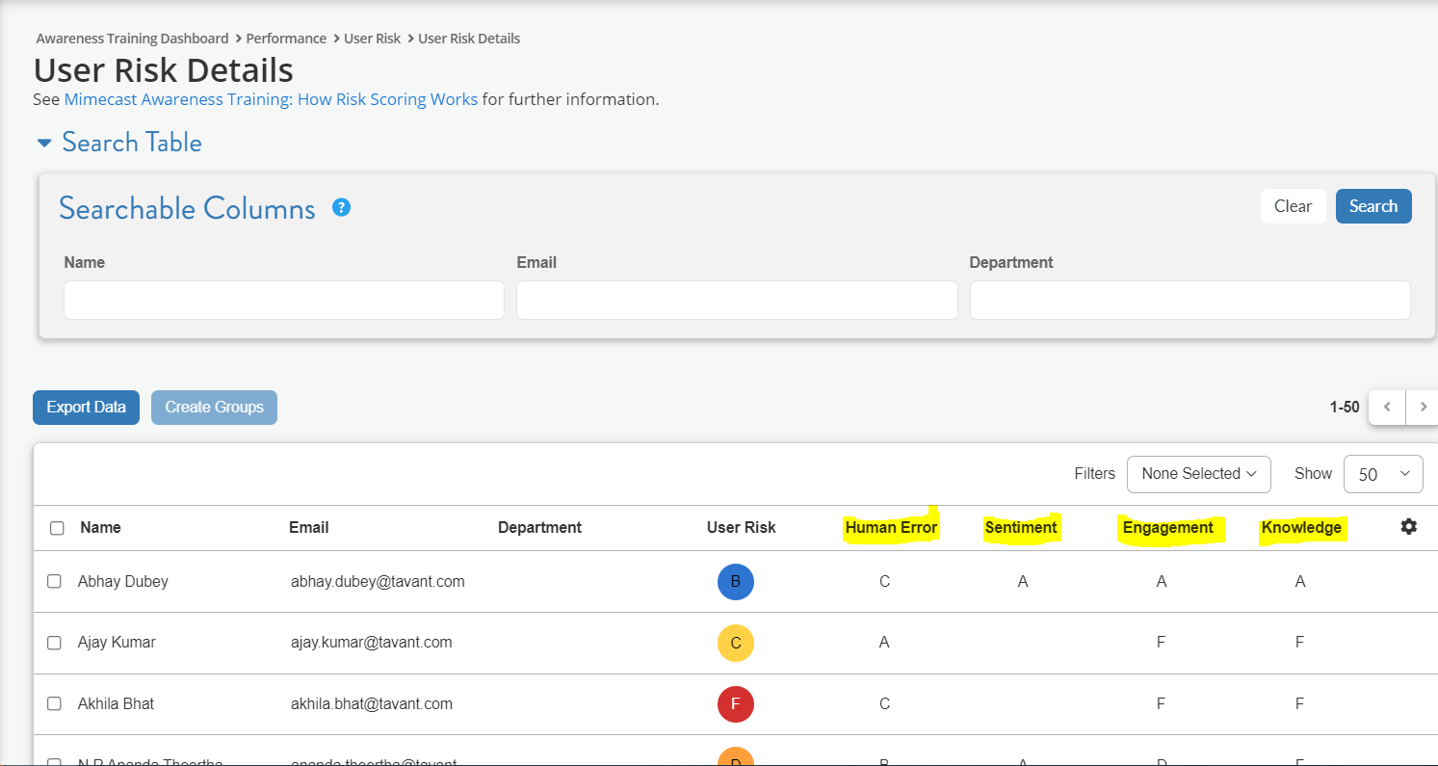
Mimecast ‘Awareness’ module - SOP
Note:- User Risk is calculated on the basis of four factors i.e. : human error, sentiment, engagement and knowledge

Slide 13
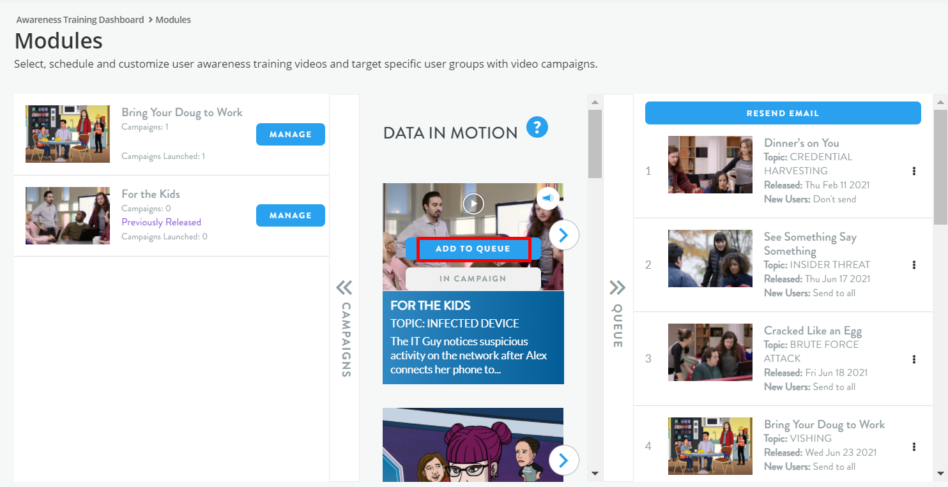
Mimecast ‘Awareness’ module - SOP
Modules: By using this tab, we can schedule different training program for end users and new users and campaigns for specific group.
It is divided into three sections:
Scheduled Training Campaigns: We use the campaigns when we need to assign the training modules for specific group.
Available training:- Awareness material from Mimecast
Scheduled Training Videos:- We can use the queue option to schedule the training modules for new users and existing users.

Slide 14
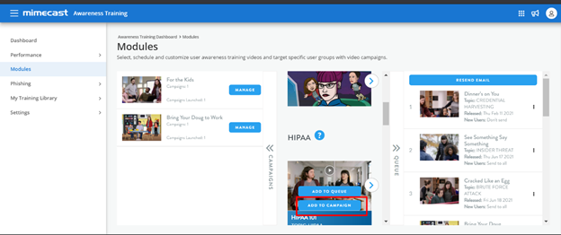
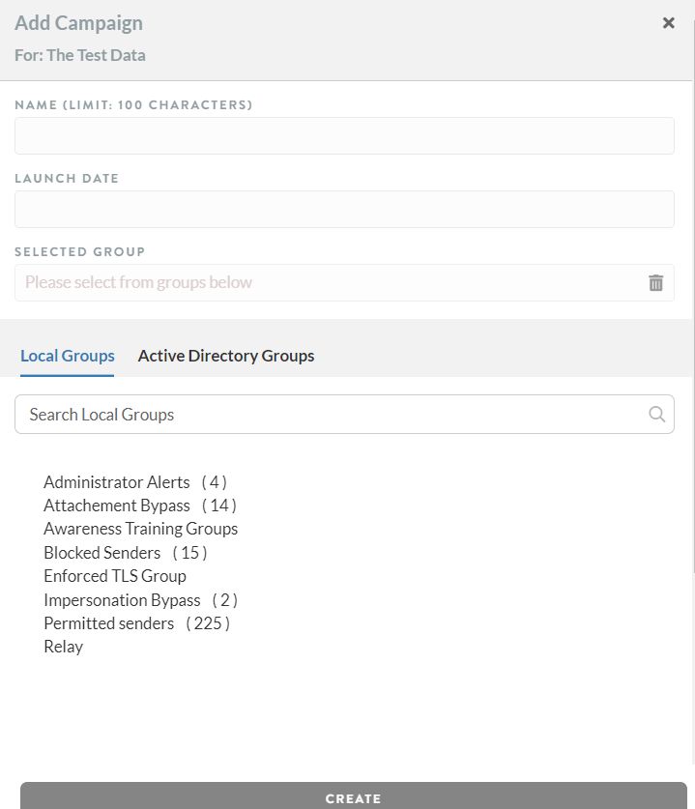
Mimecast ‘Awareness’ module - SOP
Scheduling Campaign: To schedule a campaign follow the below steps:
1.Hover over the Module Image.
2. Click on the Add to Campaign button.
3. Provide all the required details in add campaign dialog box: Enter a name for your campaign, select a group of users from the dropdown list. These are the users who will receive the training module.
4. Select Launch date and create the campaign. When the campaign will create it starts reflecting in right side.

Slide 15
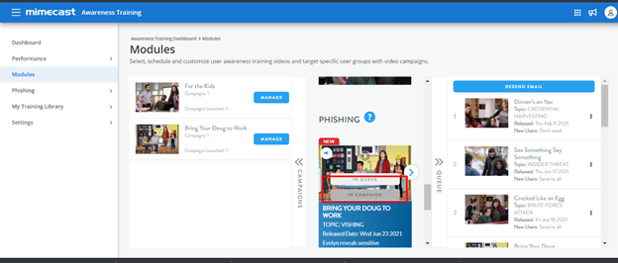
Mimecast ‘Awareness’ module - SOP
Notes:-
If module is already a part of campaign , “in campaign” button is displayed
Edit Campaign- To edit the scheduled campaign click on manage button to reschedule the launch date, modified assigned specified group.

Slide 16
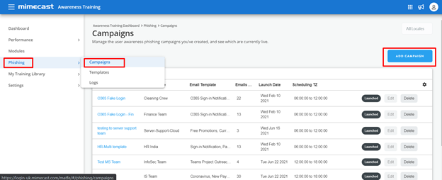
Mimecast ‘Awareness’ module - SOP
Phishing:- It allows to simulate phishing attacks and send them to groups of users as part of a campaign. To do this you need to create a Phishing campaign.

Slide 17
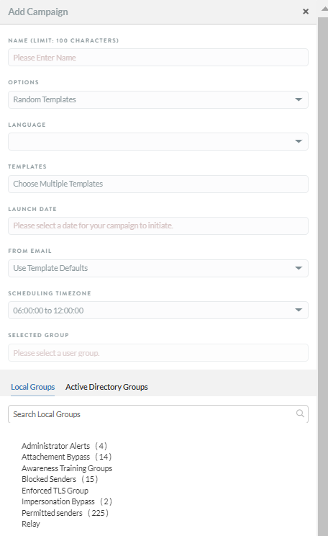
Mimecast ‘Awareness’ module - SOP
Steps to create a phishing campaign:
Click on the Campaigns button.
Click on the Add Campaign button.
Complete the Create Campaign dialog as follows:
Name- Specify a name for the campaign
Options: In options field either we can select the random templates (select more than one template in the "Templates" field, which are randomly used to send the phishing email to users) or non random templates (select only one template)
Language: Select a language from the drop-down list
Template:- Select any predefined or custom template which we want to use for a campaign
After that define the launch date and timings and select the specific group to whom we want to schedule a campaign

Slide 18
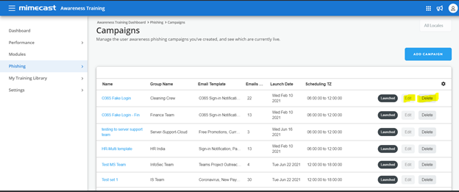
Mimecast ‘Awareness’ module - SOP
Edit Phishing Campaign: We can edit phishing campaign if campaign has not launched yet.

Slide 19
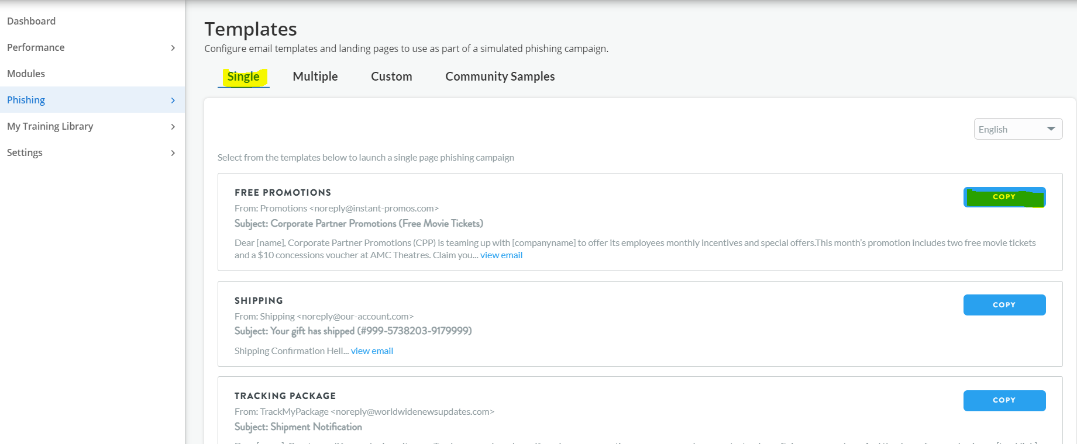
Mimecast ‘Awareness’ module - SOP
Steps to Create Custom Template:-
1. Go to Phishing and click on Single Templates option
2. Click on the Copy button to the right of a Single Page Template.

Slide 20
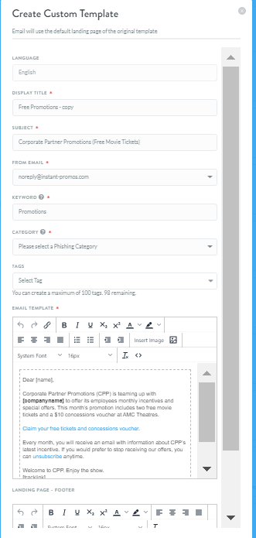
Mimecast ‘Awareness’ module - SOP
3. Complete the Create Custom Template dialog as follows:
Display Name-Specify a name to identify the template.
Subject-Specify the subject displayed in the email sent to users.
From email- Select the email address from dropdown list. This is the sender address that users see when they receive the phishing email.
Keyword-Specify a keyword that is appended to the source email address
Category- Select the category of a simulating phishing attack from dropdown list
Email Template- Use the text editor to amend the email template. This must include the following links, which are automatically embedded by default:
[rawlink] to link to the Awareness Training phishing campaign landing page.
[tracklink] must be located at the end of the template, to enable the phishing statistics to be captured.
Landing Page Footer- Customize the phishing landing page by adding up to 500 characters of text to the bottom of the landing page. No images can be added.
Note:- When it is created it will start reflecting on Custom Templates

